Slide 1

DAVID LOPEZ
Y SUS
FACULTAMIGOS
SPRINT 1 - Weather App

Slide 2
PARTICIPANTES
David Lopez
Tomás Ferro
Sabrina Moreira
Damar Moran
Ignacio Cariaga
Scrum Master
Product Owner
Team Member
Team Member
Team Member

Slide 3
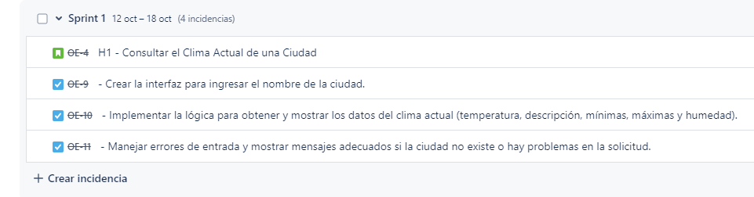
BACKLOG SPRINT 1

Slide 4
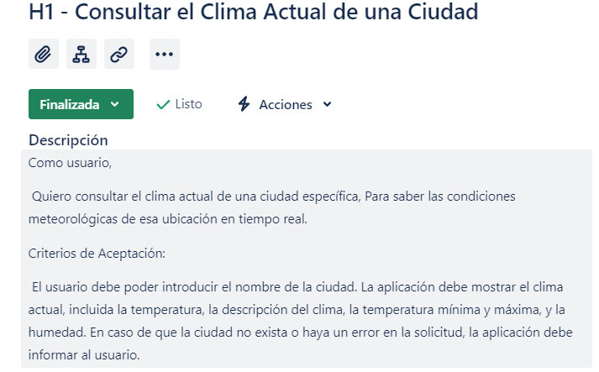
HISTORIA DE USUARIO N1

Slide 5


Slide 6
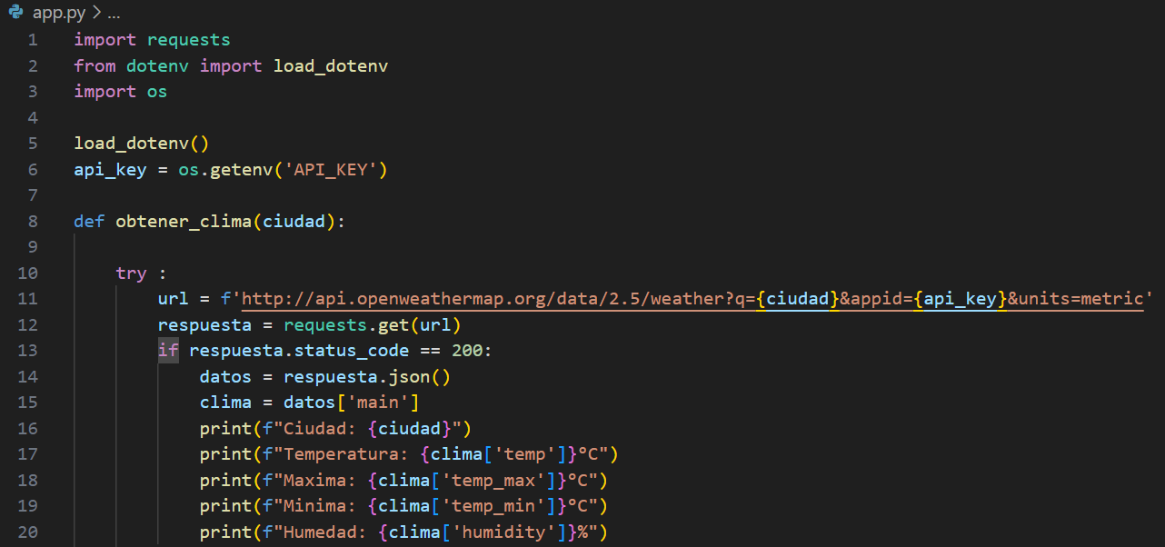

Slide 7
